Slide 1


BOTANIC MINDS
LEAVES AND PLANTS IDENTIFICATION
THROUGH IMAGE RECORGNIZATION

Slide 2
BOTANIC MINDS
Introduction
Plant Leaves Identification Using Image Recognition
Plant Leaf Identification Using Image Recognition is a computer vision project that aims to automatically identify plant species based on images of their leaves. By analyzing the unique characteristics of leaf shapes, textures, and colors, the system can accurately classify different plant species. This technology has potential applications in various fields, including botany research, agriculture, and environmental conservation.
Next

Slide 3
BOTANIC MINDS
Vision & Mission
Vision & Mission
01. VISION
To revolutionize plant identification by creating a user-friendly and accurate image recognition system that empowers individuals of all backgrounds to connect with the natural world and contribute to plant conservation
02. MISSION
Develop a cutting-edge plant identification application that leverages advanced computer vision techniques to provide reliable and accessible plant species identification.
Contribute to the conservation of endangered plant species by providing a rapid and efficient means of identification.
Create a sustainable and scalable solution that can be integrated into various platforms and devices.
Next

Slide 4
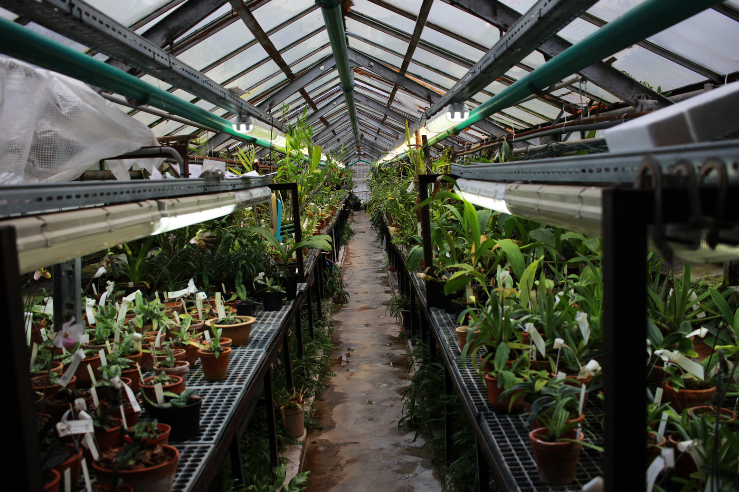

BOTANIC MINDS
Methodology
A Convolutional Neural Network (CNN) will be utilized to extract key features from a large dataset of labeled leaf images for species classification. To improve model generalization, data augmentation techniques such as rotations and flips will enhance the diversity of the training set. The trained CNN model is integrated into a user-friendly web application, enabling users to upload leaf images through an intuitive drag-and-drop interface. The system processes the image in real-time and provides a prediction of the leaf species along with a confidence score, offering a seamless and accurate plant identification experience.
Methodology:
Next

Slide 5

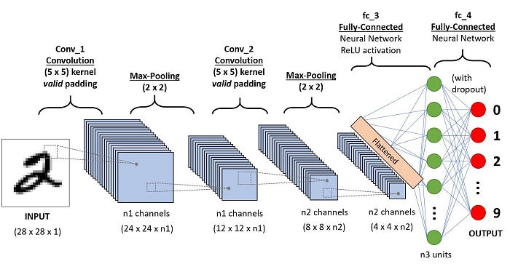
General CNN architecture
Convolutional Neural Network (CNN) Architecture:
A Convolutional Neural Network (CNN) architecture is employed to automatically learn and extract relevant features from leaf images. The CNN comprises multiple convolutional layers, each followed by pooling layers, which progressively capture the spatial hierarchies and patterns present in the images.
The input images are resized to 128x128 pixels, and the model uses multiple Conv2D layers to extract features like edges, textures, and shapes.
MaxPooling layers are applied after each convolutional block to downsample the feature maps, reducing the computational complexity and focusing on the most important features.
The architecture consists of 256 neurons in the fully connected layer followed by a softmax output layer to classify images into one of 4 possible leaf species.
The model is compiled using Adam optimizer and trained with categorical crossentropy as the loss function.

Slide 6

BOTANIC MINDS
Benifits
Benifits :
01
High Accuracy in Plant Identification
Image recognition technology offers precise identification of plant species, minimizing errors compared to manual methods.
03
Scalability and Mass Identification
Image recognition can be scaled to process large amounts of data, identifying multiple plant species in real-time.
02
Time Efficiency
Automated image recognition drastically reduces the time required to identify and classify plant species.
04
Real-Time Monitoring and Decision Making
The ability to identify plant species instantly allows for real-time data analysis and decision-making.
Next

Slide 7

BOTANIC MINDS
Conclusion
Conclusion :
This project successfully implemented image recognition techniques to accurately and efficiently identify plant species based on their leaf characteristics.
We achieved high accuracy in leaf identification, demonstrating the potential of image recognition to revolutionize plant classification.
The system is capable of real-time identification, providing instant feedback that is essential in fields such as agriculture, botany, and environmental conservation.
"In conclusion, plant leaf identification using image recognition is a powerful solution that has the potential to transform how we interact with plant species, making the process faster, more accurate, and accessible to all."
Next

Slide 8
BOTANIC MINDS
Quotes
Quotes Today
"The best way to predict the future is to invent it."
Next

Slide 9
BOTANIC MINDS
Contact
Our Contact Here
Let's work together
+123-456-7890
www.reallygreatsite.com
hello@reallygreatsite.com
123 Anywhere ST., Any City, ST 12345
Next

Slide 10
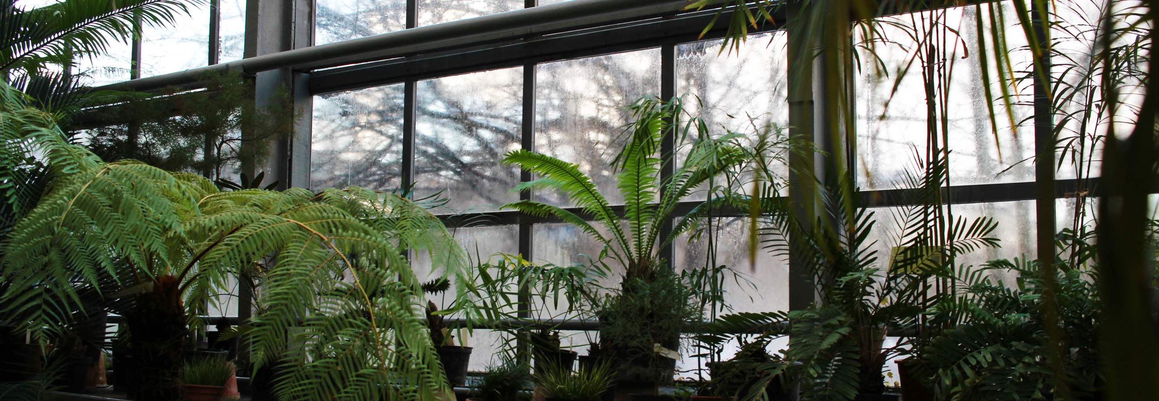
Thank You

